Slide 1
Gaining Access

Slide 2

Gaining Access
Exploit a vulnerability to gain access to the target.
Involves taking control of one or more network devices to extract data from the target or use that device to perform attacks on other targets.

Slide 3

How does a hacker gain access?

Slide 4
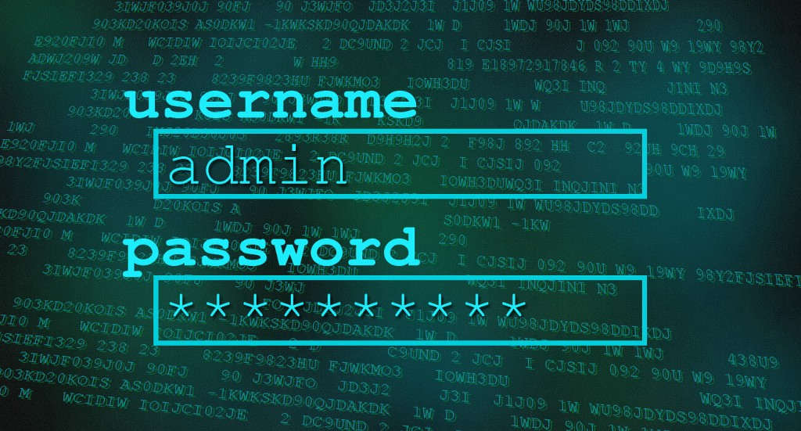
Password Cracking/Attacking
Methods like Bruteforce, dictionary attack, rule-based attack, rainbow table are used
Dictionary attack is trying a list of meaningful words until the password matches.
Rainbow table takes the hash value of the password and compares with pre-computed hash values until a match is discovered.

Slide 5
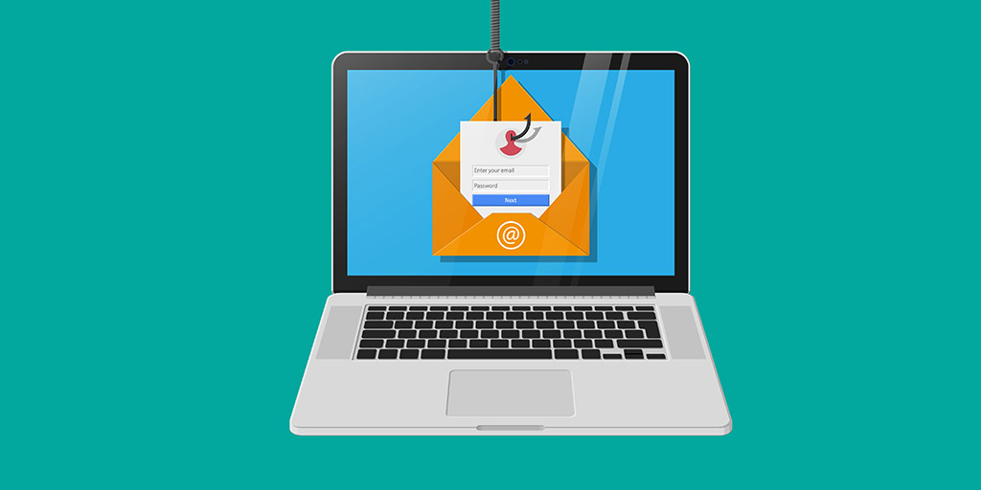
Malware
Helps in stealing or deleting sensitive data, modifying system’s core functionalities, and secretly tracking the victim’s activities.
Various factors that can lead to the installation of malware
Older or pirated version of an operating system
Clicking on unknown links or installing fake/pirated software

Slide 6
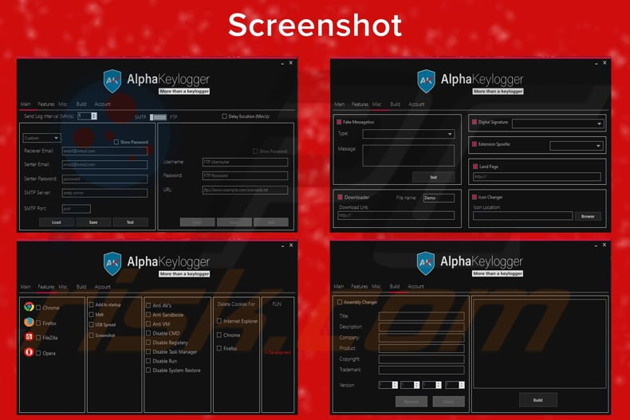
Log keystrokes
Allow hackers to review every keystroke a computer user makes.
Once installed on a victim's computer, the programs record each keystroke.

Slide 7

Gain backdoor access
Search for unprotected pathways into network systems and computers.
To infect a computer or system with a Trojan horse.

Slide 8
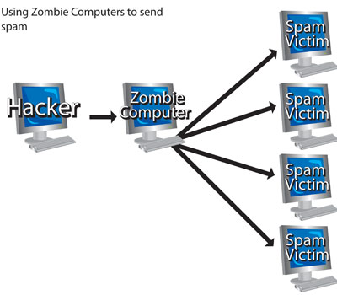
Create zombie computers
A zombie computer, or bot, is a computer that a hacker can use to send spam or commit Distributed Denial of Service (DDoS) attacks.
After a victim executes seemingly innocent code, a connection opens between his computer and the hacker's system.
The hacker can secretly control the
victim's computer, using it to commit crimes
or spread spam.

Slide 9
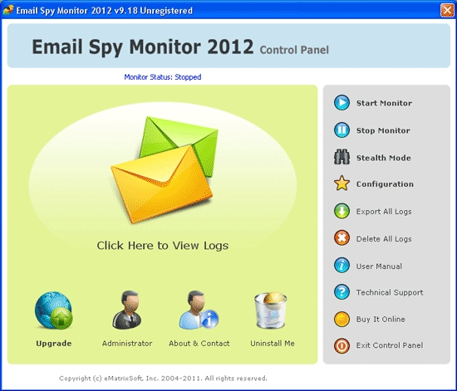
Spy on e-mail/Email spoofing
Hackers have created code that let them intercept and read e-mail messages –
Most e-mail programs use encryption formulas so complex that even if a hacker intercepts the message, he won't be able to read it.

Slide 10
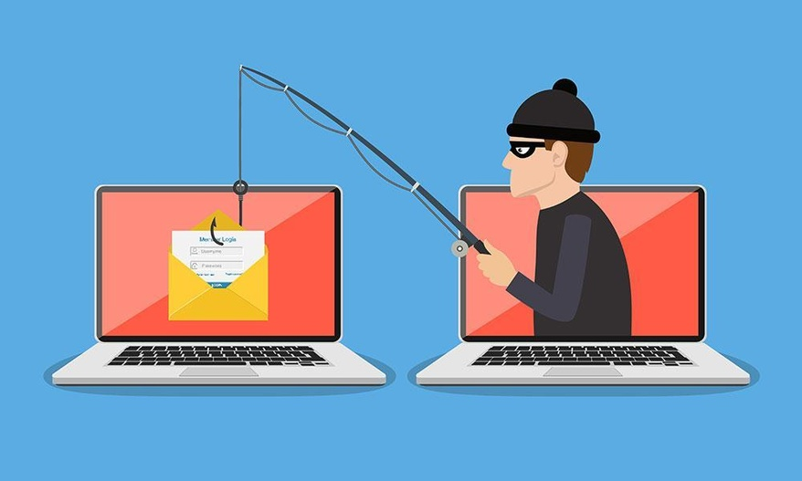
Phishing
Try to create an urgency or panic to trick users into giving out their personal details.
Other ways
Popups,
Interactive links,
Forms,
Fake login boxes

Slide 11
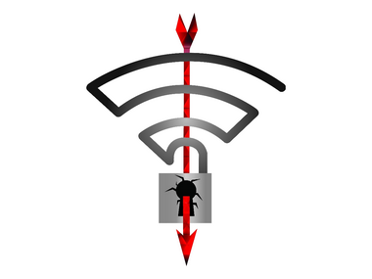
Insecure networks
Connecting to a “free” airport/coffee shop WiFis is dangerous such as banking, private conversation or even browsing your email.
Networks are often left unprotected which can allow a malicious hacker in the same shop/region to snoop on you easily.

Slide 12
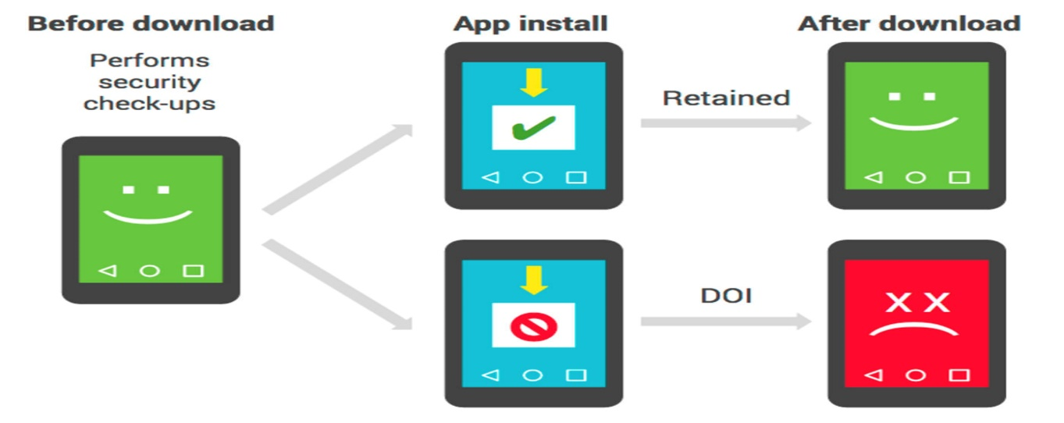
Malicious apps
The malicious apps may contain a code snippet that can install malware on your device.
Besides this, the app may ask for unnecessary permissions that hackers may Accounts access: It helps collect crucial data including contact lists and e-mail addresses. SMS permission: It can be used to send SMSs to premium-rate numbers and drain out your balance.
Microphone access: It can record phone conversations.
Device admin permission: It can help a hacker take remo

Slide 13
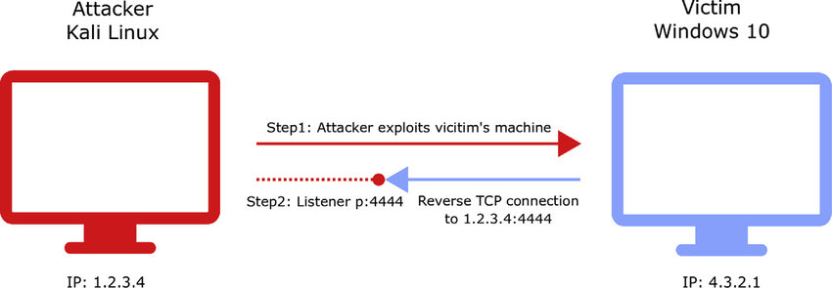
Metasploit
Reverse TCP/IP shell using Metasploit
PDF
Word File
Flash player
etc
They can set up a Evil Twin router and try to Man in the Middle attack users to gain access.

